Slide 1
Control Structures and Loops

Slide 2
Control statements
if
if….else
if…elif…..else
while
for
else suite
break
continue
pass
assert
return

Slide 3
If Else Statements
n=int(input(“number”))
if n<0:
print(“the value of “, n, “is”, -n)
else:
print(“the value of “,n , “is “, n)
sum=50+70
Print(sum)

Slide 4
name=input(“names”)
if name==“seri”:
print(“the name entered is”, name)
elif name==“rittu”
print(“the name entered is “, name)
else:
print(“invalid”)

Slide 5
Nested If
if name=“plant”
Plant name=“rose”
if name==“plant”:
if plant name==“rose”:
print(“valid”)
else:
print(“is valid”)
else:
print(“invalid”)

Slide 6
Else suite
for with else syntax
for( var in sequence)
statements
else:
statements
while with else syntax
while( condition ):
statements
else:
statements

Slide 7
Pass statement
The usage of pass statement is to inform the python interpreter not to do anything when we are not interested in the result.
Retrieving only the negative numbers from the list
num=[1,2,3,-4,-5,-6,-7,8,9]
for i in num
if(i>0):
pass
else:
print(i)

Slide 8
Assert statement
The assert statement is useful to check if a particular condition is fulfilled or not.
assert expression , message
assert x>0. “wrong input entered”
In this case, the python interpreter checks if x>0 is true or not.
If it is true, then the next statements will execute, else it will display AssertionError along with the message

Slide 9
Looping Statements
a=0
while a<5:
print (a)
a+=1
a=1
sum=0
print(“Enter the number to add to sum: ”)
print (“Enter 0 to quit:”)
while a!=0:
print (“sum is :”,sum)
a=float(input(“number: ”))
a=float(a)
Sum+=a
print(“total sum =“, sum)

Slide 10
b=[3,4,5,6,7,8,9,1,2]
for num in b:
print (num)
Output:
3
4
5
6
7
8
9
1
2

Slide 11
Break
The break statement terminates the loop containing it. Control of the program flows to the statement immediately after the body of the loop.
If break statement is inside a nested loop (loop inside another loop), break will terminate the innermost loop.
Syntax of break
break

Slide 12
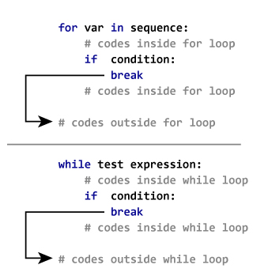

Slide 13
The working of break statement in for loop and while loop is shown below.
Example:
Use of break statement inside loop
for val in "string":
if val == "i":
break
print(val)
print("The end")
In this program, we iterate through the "string" sequence. We check if the letter is "i", upon which we break from the loop. Hence, we see in our output that all the letters up till "i" gets printed. After that, the loop terminates.

Slide 14
continue
The continue statement is used to skip the rest of the code inside a loop for the
current iteration only. Loop does not terminate but continues on with the next
iteration.
Syntax of Continue
The working of continue statement in for and while loop is shown below.
for val in "string":
if val == "i":
continue
print(val)
print("The end")

Slide 15
Output:
s
t
r
n
g
This program is same as the above example except the break statement has been replaced with continue.
We continue with the loop, if the string is "i", not executing the rest of the block. Hence, we see in our output that all the letters except "i" gets printed.

